Slide 1
The Nicene Creed
Session 1:
Creeds Before Nicaea & The First Nicene Creed
Rev. Dr. Ed Roslof
St. Alban’s Episcopal Church
Washington, DC
March 3, 2019

Slide 2
The Nicene Creed
We believe in one God, the Father, the Almighty, maker of heaven and earth, of all that is, seen and unseen. We believe in one Lord, Jesus Christ, the only Son of God, eternally begotten of the Father, God from God, Light from Light, true God from true God, begotten, not made, of one Being with the Father. Through him all things were made. For us and for our salvation he came down from heaven: by the power of the Holy Spirit he became incarnate from the Virgin Mary, and was made man. For our sake he was crucified under Pontius Pilate; he suffered death and was buried. On the third day he rose again in accordance with the Scriptures; he ascended into heaven and is seated at the right hand of the Father. He will come again in glory to judge the living and the dead, and his kingdom will have no end. We believe in the Holy Spirit, the Lord, the giver of life, who proceeds from the Father and the Son. With the Father and the Son he is worshiped and glorified. He has spoken through the Prophets. We believe in one holy catholic and apostolic Church. We acknowledge one baptism for the forgiveness of sins. We look for the resurrection of the dead, and the life of the world to come.

Slide 3
What is a creed?
noun
1. a system of Christian or other religious belief; a faith.
synonyms: faith, religion, religious belief(s), religious persuasion, religious conviction, religious group, faith community, church
2. a formal statement of Christian beliefs, especially the Apostles' Creed or the Nicene Creed.
synonyms: system of belief, set of principles, statement of beliefs, profession of faith
3. a set of beliefs or aims which guide someone's actions.
"liberalism was more than a political creed"

Slide 4
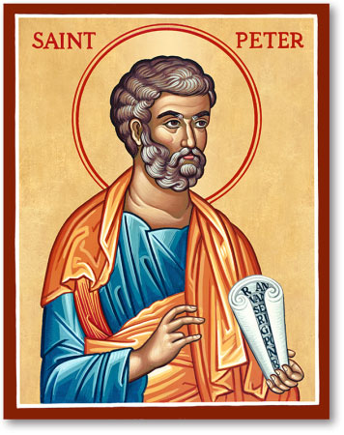
An 8th century sermon: “0n the 10th day after the Ascension, when the disciples were gathered together for fear of the Jews, the Lord sent the promised Holy Spirit on them. They were inflamed like red-hot iron and composed the creed…
“I believe in God, the Father almighty, maker of heaven and earth;

Slide 5
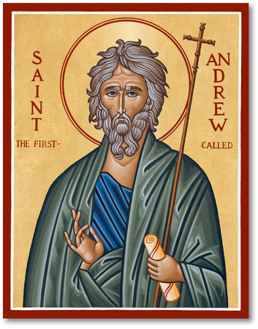
An 8th century sermon: “0n the 10th day after the Ascension, when the disciples were gathered together for fear of the Jews, the Lord sent the promised Holy Spirit on them. They were inflamed like red-hot iron and composed the creed…
“I believe in God, the Father almighty, maker of heaven and earth; and in Jesus Christ, his only Son, our Lord.

Slide 6
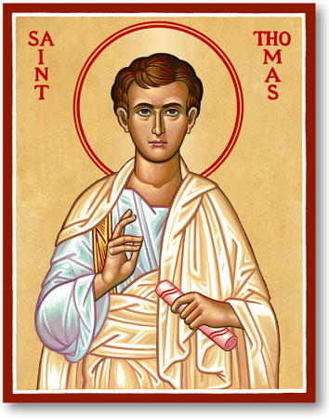
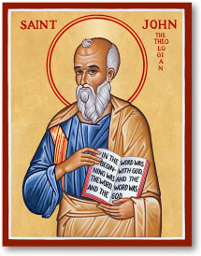
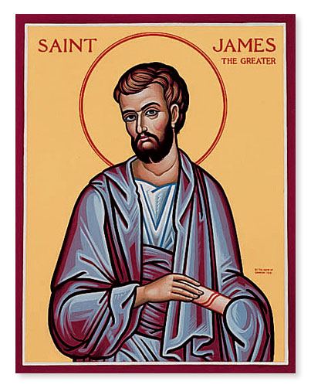
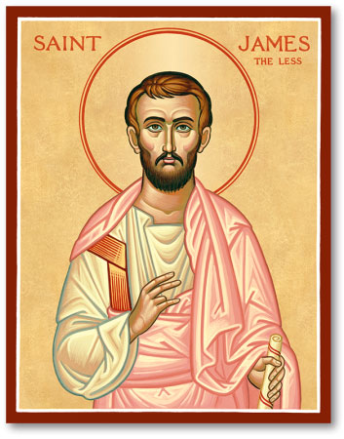
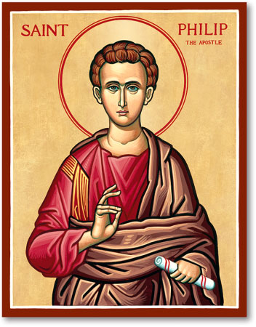
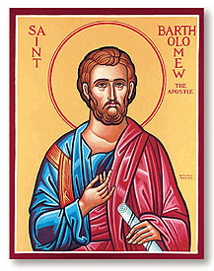
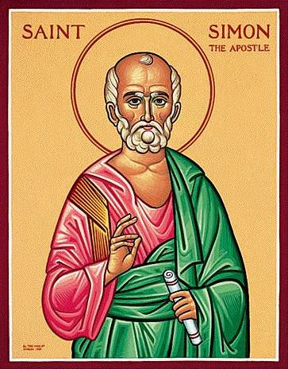
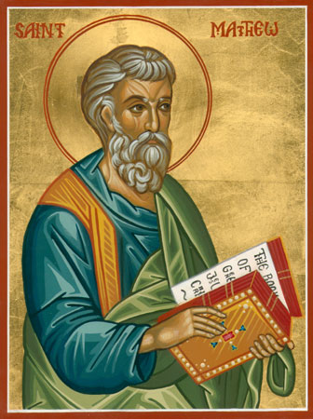
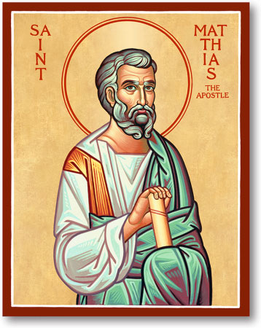
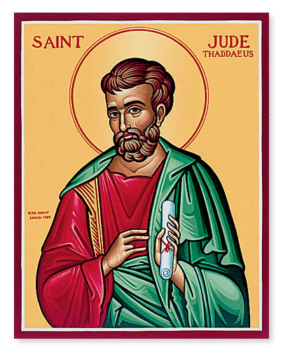
An 8th century sermon: “0n the 10th day after the Ascension, when the disciples were gathered together for fear of the Jews, the Lord sent the promised Holy Spirit on them. They were inflamed like red-hot iron and composed the creed…
“I believe in God, the Father almighty, maker of heaven and earth; and in Jesus Christ, his only Son, our Lord. Who was conceived by the power of the Holy Spirit and born of the Virgin Mary. He suffered under Pontius Pilate, was crucified, died, and was buried. He descended into hell and On the third day he rose again. He ascended into heaven, and is seated at the right hand of the Father. He will come again to judge the living and the dead. I believe in the Holy Spirit, the holy catholic Church, the communion of saints, the forgiveness of sins the resurrection of the body, and eternal life.”
(The “Apostles’ Creed”)

Slide 7
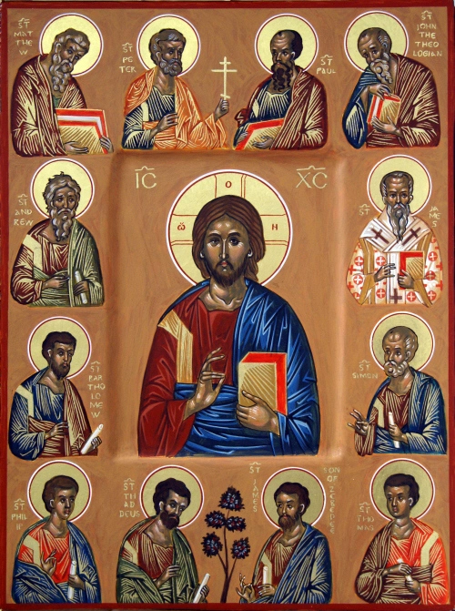
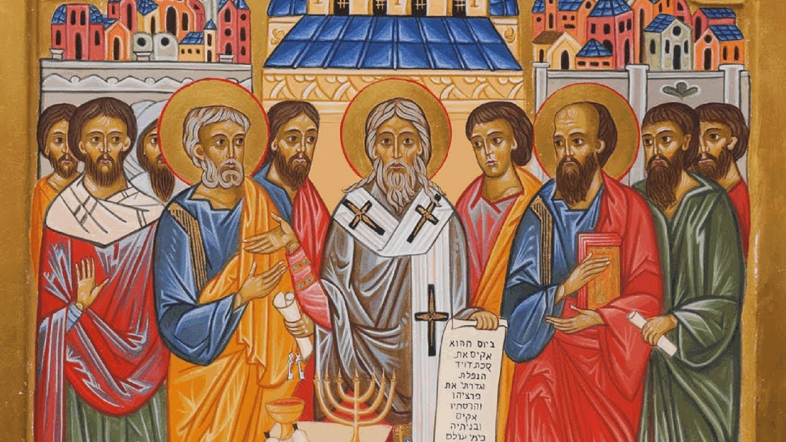
Two Standards for Church Doctrine
APOSTLES
COUNCILS
Council at Jerusalem, 50 AD
(Acts 15)

Slide 8
Definition of Declaratory Creed
A declaratory creed is:
a series of short statements
expressed in the first person (statements start with “I” or “we”)
an affirmation of belief in selected facts and doctrines
based on the understanding that those selected facts/doctrines are vital and essential and most important for faith

Slide 9
5 Steps to the Nicene Creed
New Testament Affirmation
Baptismal Interrogation
Catechumen Preparation
Theological Disputation
Political Accommodation

Slide 10
Step 1: Three New Testament Credal Affirmations
“Jesus is Lord”
“Jesus is the Son of God”
“God the Father, Christ the Son, the Holy Spirit”
There is no evidence that Christians in the first century had a declaratory creed.

Slide 11
Step 2: Baptismal Interrogation
“Do you believe in God the Father almighty?”
“I believe” (first immersion)
“Do you believe in our Lord Jesus Christ and His cross?”
“I believe” (second immersion)
“Do you also believe in the Holy Spirit?”
“I believe” (third immersion)
“Your three-fold confession wipes out the many failings and sins of your earlier life.”

Slide 12
Step 3: Catechumen Preparation
Old Roman Creed
Creed from Caesarea
I believe in God the Father almighty;
and in Christ Jesus His only Son, our Lord,
Who was born from the Holy Spirit and the Virgin Mary,
Who under Pontius Pilate was crucified and buried,
on the third day rose again from the dead,
ascended to heaven,
sits at the right hand of the Father,
whence He will come to judge the living and the dead;
and in the Holy Spirit,
the holy Church,
the remission of sins,
the resurrection of the flesh.
We believe in one God the Father, Almighty, maker of all things visible and invisible;
And in one Lord Jesus Christ, the Word of God, God from God, Light from Light, Life from Life, the Son only-begotten, the first-born of every creature, begotten of the Father before all ages, through Him all things came into being; who for our salvation was made flesh and made his home among human beings; and suffered; and rose again on the third day; and ascended to the Father; and will come again in glory, to judge the living and the dead.
We believe also in one Holy Spirit.

Slide 13
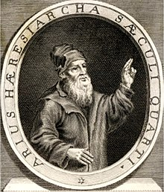
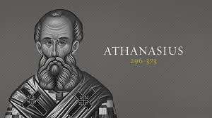
Step 4: Theological Disputations
Athanasius
Arius
“God became human so that humans could become gods.”
“There was a time when the Son was not."

Slide 14
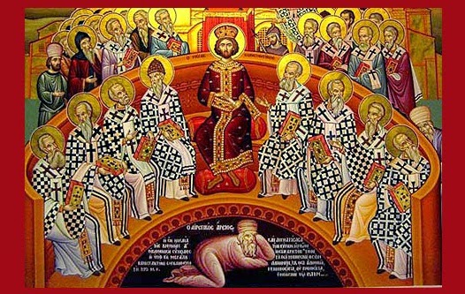
Step 5: Political Accommodation
First Council of Nicaea, 325 AD

