Slide 1
waiting with mary
Mary in Art

Slide 2
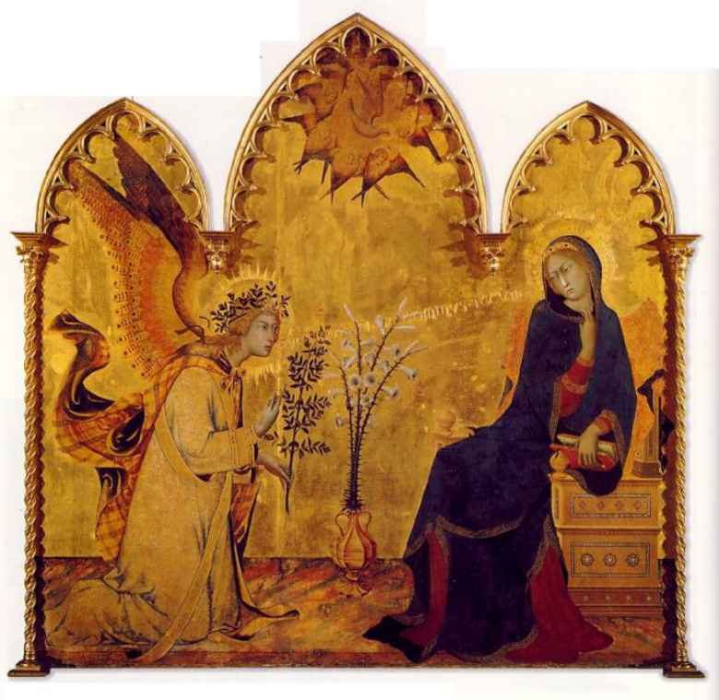
The Annunciation
Simone Martini, 1333
Uffizi Gallery, Florence

Slide 3
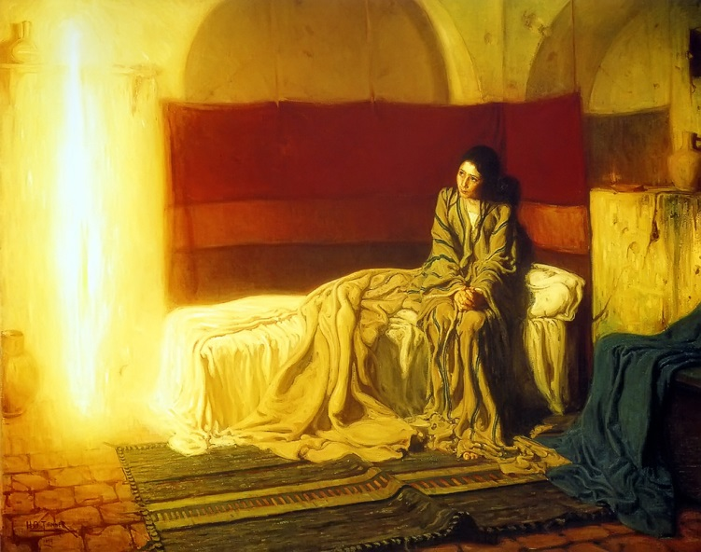
The Annunciation
Henry Ossawa Tanner 1898
Philadelphia Museum of Art

Slide 4
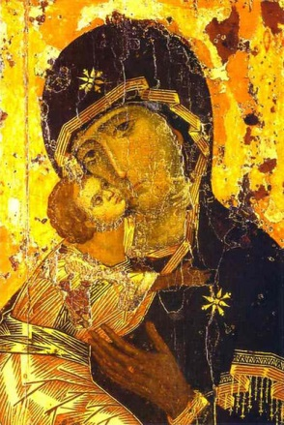
Our Lady of Vladimir
12th century
Church of St. Nicholas in Tolmachi
Tretyakov Gallery, Moscow

Slide 5
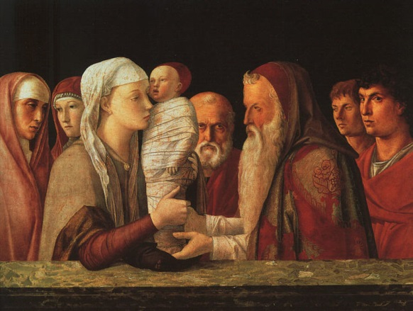
The Presentation at the Temple
Giovanni Bellini - c1459
Galleria Querini Stampalia, Venice

Slide 6
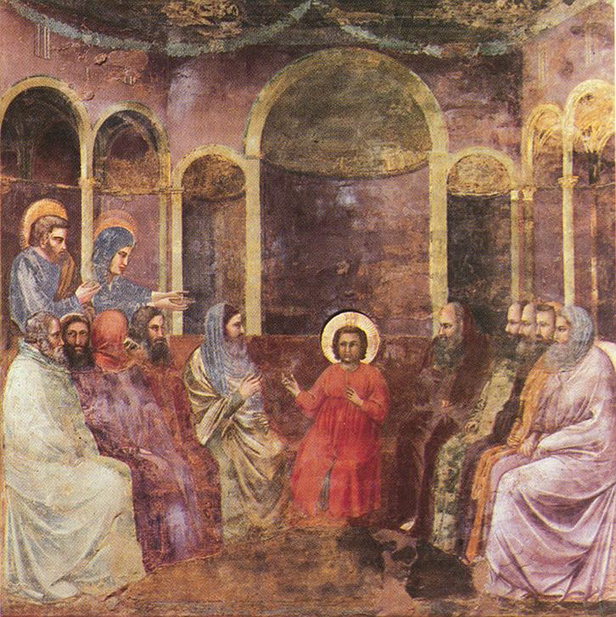
Christ among the Doctors
Giotto c. 1305
Scrovegni Chapel, Padua

Slide 7
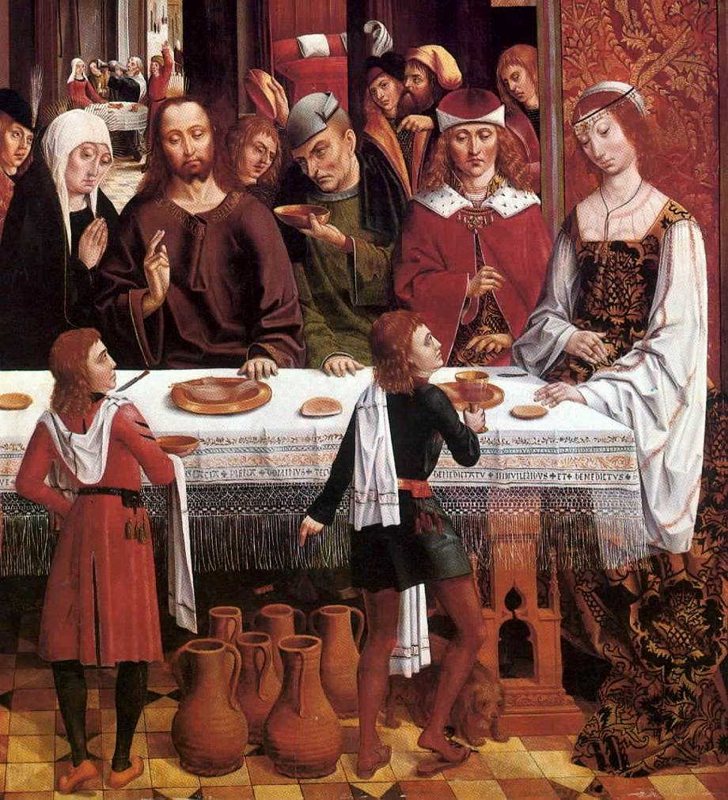
Marriage at Cana (Detail)
Master of the Catholic Kings 1495/1497
National Gallery of Art, DC

Slide 8
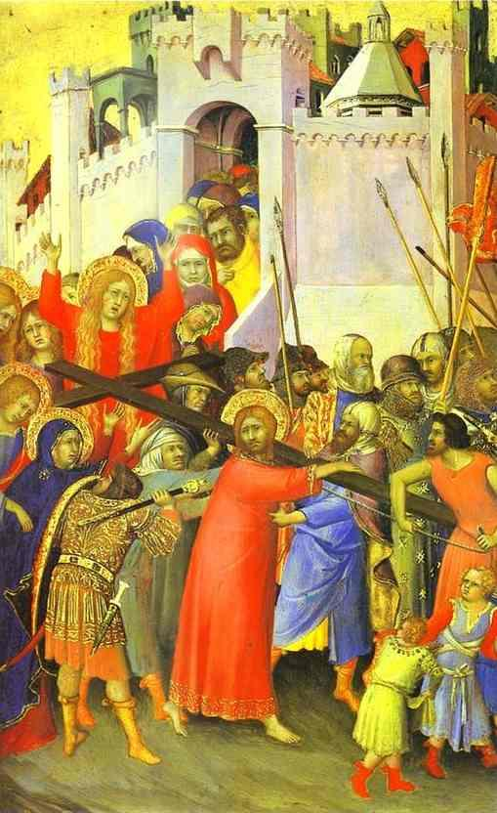
Road to Calvary – part of Orsini Polyptych
Simone Martini c1315
The Louvre, Paris

Slide 9
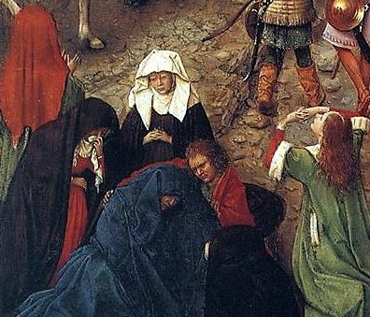
Detail from Crucifixion and Last Judgment diptych
Jan Van Eyck c1430
Metropolitan Museum of Art, New York

Slide 10
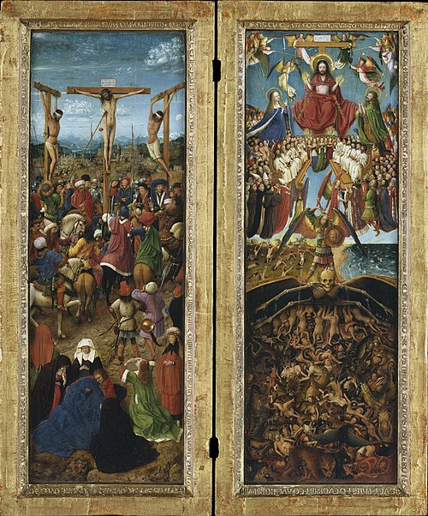
Crucifixion and Last Judgment diptych
Jan Van Eyck c1430
Metropolitan Museum of Art, New York

Slide 11
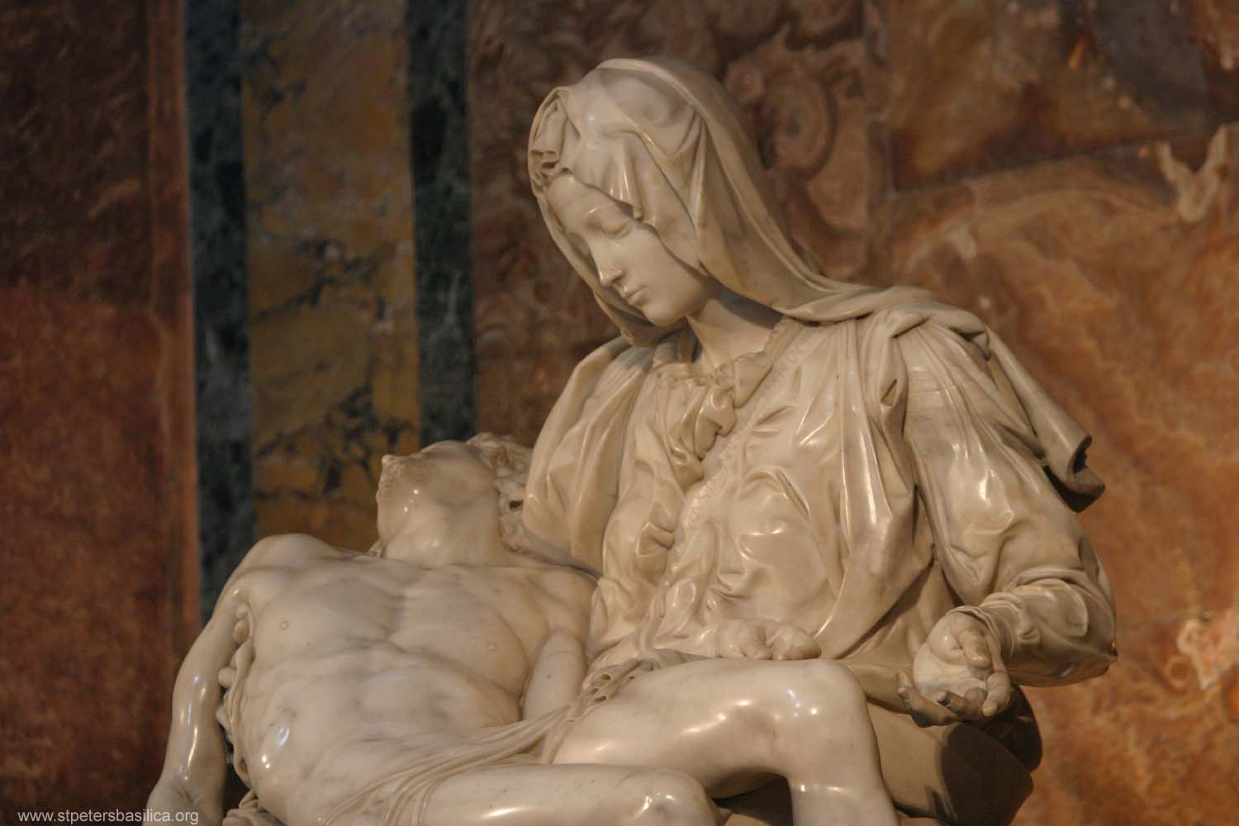
Pieta
Michelangelo 1498-1499
St. Peter’s Basilica, Vatican City

Slide 12
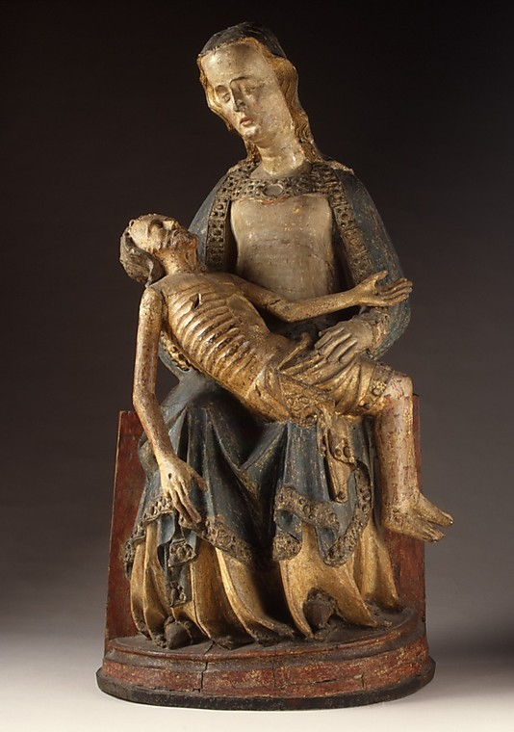
Pieta
Made in Rhine Valley, Germany 1375-1400
The Cloisters, Metropolitan Museum of Art

Slide 13
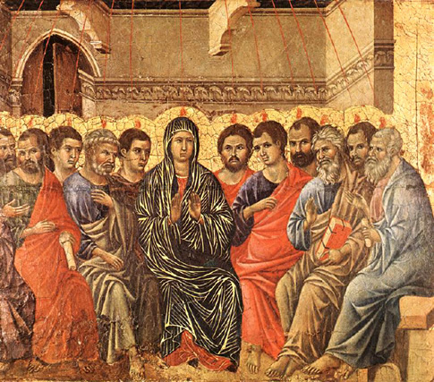
Pentecost
Duccio di Buoninsegna, 1308
Museo dell'Opera del Duomo, Siena

Slide 14
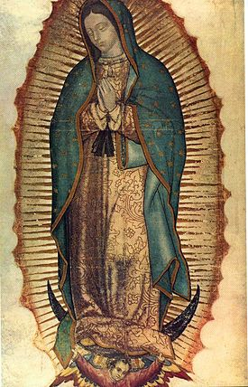
Our Lady of Guadalupe
Original Vision Seen 1531
Minor Basilica of Our Lady of Guadalupe, Mexico City

