Slide 1
Confronting Racism: Unconscious Bias
St. Albans Church
February 10, 2019

Slide 2
What is Implicit or Unconscious Bias?
Mental associations without awareness, intention or control
A tendency or inclination that results in judgement without question
Notes:
Bias at its core is based on our automatic tendencies towards fight or flight. The ability of the human mind to categorize information

Slide 4
John Ridley Stroop, 1935
SLB | CFLTK | CFLTK
SPRND | HLMG | CFLTK
SLB | SPRND | SLB
SPRND | HLMG | CFLTK
HLMG | SPRND | CFLTK
Notes:
TIME: 1 min
SAY: Let’s look at an example that allows us to experience the difference between fast brain and slow brain. This experiment was done by American psychologist John Ridley Stroop in 1935.
DO: Ask participants to all together call out loud the color of the letters in each box, as you click through them steady pace. This will be easy for participants and they will get all of them right.
SAY: Pretty easy, wasn’t it? Let’s try it one more time.
4
Cook Ross Inc. © 2015
May be used only with express permission.

Slide 5
John Ridley Stroop, 1935
RED | GREEN | YELLOW
BLUE | GREEN | BROWN
PURPLE | YELLOW | BLUE
BROWN | BROWN | BLUE
YELLOW | GREEN | RED
Notes:
TIME: 1 min
DO: Click through them in the same steady pace as the set before.
NOTE: Because the words and the colors of the letters are not the same, participants will have trouble quickly calling out the right color of the letters, and might get confused between the words and the colors. This often leads to a little bit of chaos and laughter, but keep clicking until you’ve gone through all the boxes.
SAY: This was a bit harder, wasn’t it? Why was that? That’s right, because the letters formed a word that indicated a different color than the colors of the letters themselves. It confuses our fast brains, which either causes us to give the wrong answer or forces us to move the analysis/interpretation to the slow brain. It takes us longer to process this information when we do that, causing a delay in our answers.
Cook Ross Inc. © 2015
May be used only with express permission.

Slide 6
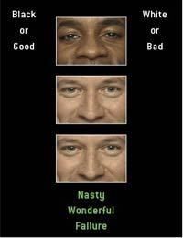
Implicit Association Test (Harvard)
https://implicit.harvard.edu/implicit/selectatest.html
Notes:
Gender-Science: This IAT often reveals a relative link between liberal arts and females and between science and males.
Race: This IAT indicates that most Americans have an automatic preference for white over black
Gender-Career: This IAT often reveals a relative link between family and females and between career and males

Slide 7
Focusing on Unconscious Bias
Unconscious bias is simply listening through the lens of our experiences. Our brains are hard-wired to create shortcuts and associations both as a “fight or flight” evolutionary response and to efficiently manage millions of pieces of data/stimuli.
The problem with unconscious bias is that decisions are made every day that can have an adverse impact in the workplace especially in hiring, promotion, rewards, assignments, professional development
Notes:
Today we will cover bias both explicit and implicit but we will spend most of our time with illustrations of implicit or unconscious bias because it is so common in the workplace.
In 2014 Dr. Arin Reeves undertook a study with the hypothesis that unconscious confirmation bias in a supervising lawyer’s assessment of legal writing would result in a more negative rating if that writing was submitted by an African American lawyer in comparison to the same submission by a Caucasian lawyer. In the study, a legal memo was written that intentionally included mistakes in grammar, logic, etc. It was said to be written by Thomas Meyer, a student at NYU Law School. The memo was sent to 60 partners at law firms, who were asked to judge the potential of Thomas Meyer and to offer feedback. Thomas Meyer was identified as white to half of the partners and as black to the others. The white Thomas Meyer was rated much higher, given more positive feedback and was seen as having much more potential than the black Thomas Meyer, whose (identical) memo was not only scored worse, but the partners found additional errors in his work and gave him very negative feedback; one partner scribbled on the memo, “I can’t believe this person graduated from NYU.”
Biases for non-dominant groups like racial and ethnic groups make take the form of stereotypes and microinequities/microagressions. Individuals may be judged, included, excluded, "heard" or dismissed based on in-part on racial identity. The invitation to demonstrate authenticity for diverse leaders may feel risky because they have either seen bias play our before with negative consequences or worry about negative consequences also some feel unsupported in some organizational cultures.

Slide 8
Discussion: What shapes your lens?
Early relationships
Norms of behavior
Family values
Eye contact
Geography
Language
Beliefs
Health
Rules
Friends and Colleagues
Socioeconomic status
Political preferences
Sexual orientation
Gender identity
Generation
Ability
Faith
Race
formative experiences
social identity
Media
Schools
Community
Government
Civic affiliations
Social networks
Religious institutions
Professional organizations
External events
Education
Profession
Adversity
Cultural events
Personal events
Historical events
Exposure to difference
systems
Notes:
There are many factors that shape how you see the world around you.
Formative experiences leave a lasting impression, from the early relationships you encounter to family values and norms to the language you speak...
Social identity influences how you view and how you engage, from the friends and colleagues you surround yourself with to core aspects of your identity that you bring to the forefront as you grow…
External events shape perception, from interactions in educational and professional environments to historical events to the degree to which you are exposed to difference…
The systems around us also imprint how we see, from the media and social media that is so readily accessible to us all today to the long-standing institutions that are part of the fabric of our lives...

Slide 9
Take a P.A.U.S.E. A quick way to check your reaction.
P
Pay attention to what’s actually happening, beneath the judgments and assessments
A
Acknowledge your own reactions, interpretations and judgments
E
Execute your action plan
U
S
Understand the other possible reactions, interpretations and judgments that may be possible
Search for the most empowering, productive way to deal with the situation
Notes:
Participant Guide reference p.13 for taking notes
TIME: 3 min
SAY: The first important thing to do in any situation, is to quickly check your reaction by taking a pause.
DO: Click to reveal each step as you are reading what is on each section. Provide a personal example of when you did or could have applied this model, demonstrating how you would perform each step.
Cook Ross Inc. © 2015
May be used only with express permission.

Slide 11
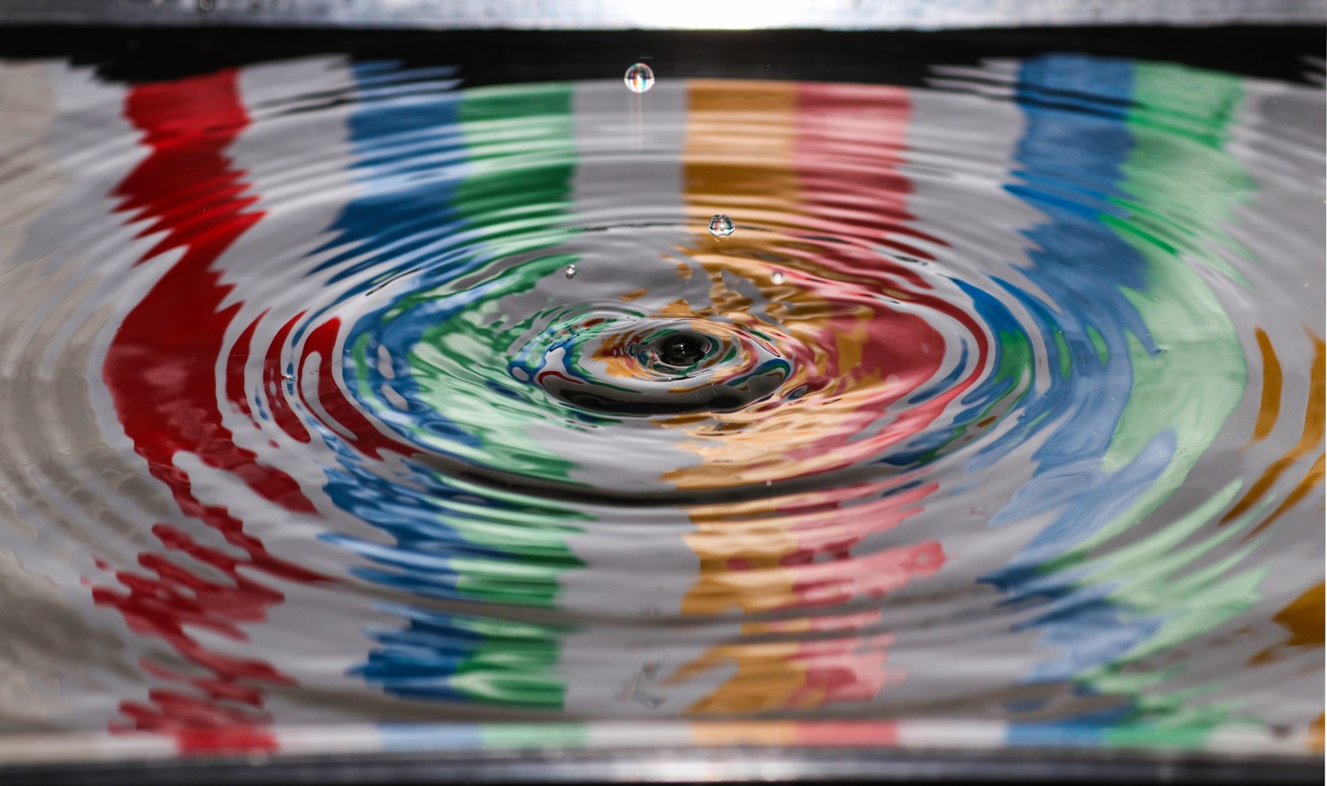
Discuss
What will you take on as a result of today’s discussion?
Notes:
5:23 p.m.
Kim

